Slide 1
A Comparative
Outcome Analysis of
Recovery Residences
Nina ward

Slide 2
Substance Use Disorders
Substance use disorders (SUDs) are mild, moderate, or severe “recurrent use
of alcohol and/or drugs that causes clinically and functionally significant
impairment”
Addiction is a chronic disease that causes compulsive drug seeking, despite
harmful consequences
In 2015, 20.8 million people in the US had a SUD
NIDA estimates that abuse of alcohol and illicit drugs costs more than $400
billion annually

Slide 3
Recovery
Recovery is possible through sustained abstinence from all substances
Four stages of recovery
  Intervention
  Detoxification
  Treatment
  Long-term behavioral changes
Research on the role of recovery residences in overcoming the final stage has
shown promising results

Slide 4
Recovery Residences
The theory: “removing clients from destructive living environments that
encourage substance use and creating new social support systems in
treatment” will foster and lead to the behavioral changes necessary to sustain
long-term abstinence (Polcin, et al. 2010).
A range of living environments
All residences are predicated on the social support aspect of recovery and at a
minimum, offer peer-to-peer recovery support.
Every person living in the residence is sober and in recovery and alcohol and
drug use is not allowed.

Slide 5
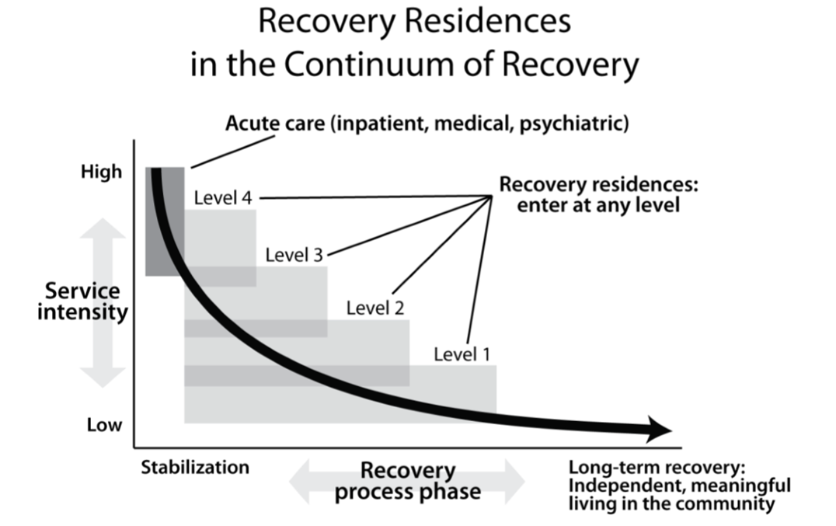
Recovery Residences in this Analysis
Oxford Houses
Sober Living Houses
Halfway Houses
Therapeutic Communities
Image Source: Jason, L.A., Mericle, A.A., Polcin, D.L., White, W.L. & the National Association of
Recovery Residences (with Fred Way serving as Liaison with Research Committee). 2012.

Slide 6
 | Oxford House | Sober Living House | Halfway House | Therapeutic Community
Number of houses/residents | 2,127 houses 16,833 recovery beds | Unknown—no organizing body | Unknown | Unknown
Operations Management | Self-operated democratically | House manager | Multiple staff on-site, facility manager | Medical/management staff 24/7
Finance Structure | Residents pay as a group | Residents pay individually | Residents pay individually; public funding | Residents pay fee; insurance coverage
Cost per resident per month | $515 | $545 | No information | $3510
Time Limit | None | None | 3 – 12 months | 6 – 15 months
Average stay | 9.1 months | 6 months | 6 months | No information
Treatment | No formal treatment, only peer support | No formal treatment, require 12-step group | Monitored; group activities, 12-step groups | Heavily monitored, set schedule

Slide 7
Methodology
Disentangle which type of residence is the most effective and which is the
most efficient.
Effective: undisrupted sobriety 12 months after leaving a recovery residence
Efficient: lowest cost model to operate and the lowest cost model to
government resources

Slide 8
Data
Data was collected from a variety of sources
  Government sources
  Academic studies
  Interviews with experts in the field, OHI leadership, and residents of SLHs and TCs
Determine how characteristics of each residence affect sobriety and where
evidence of this already exists

Slide 9
Outcomes
 | Oxford House | Sober Living House | Halfway House | Therapeutic Community | Return to prior living situation
Success (sobriety) rate at 12 months | 81.5% | 56.5% | No information available | 45 – 75% | 2 – 12%

Slide 10
Findings -- Effectiveness
Effectiveness of Oxford Houses is a result of several characteristics
unique to this model:
  No residency time limit
  Governing structure
  Immediate expulsion for drug or alcohol use; recovery without relapse

Slide 11
Findings – Efficiency, Selection Bias, Data
Efficiency
  Oxford House: $515/month per resident on average
  Sober living houses: $545/month per resident on average
  Therapeutic communities: $3510/month per resident on average
Selection Bias
Data Availability

Slide 12
Limitations
Secondary Data
Variance within the recovery residence models
One outcome

Slide 13
Future Research
Based on these findings, Oxford Houses are the leading recovery residence
model in terms of effectiveness and efficiency
Because this analysis was based on secondary data, it is recommended that
original data for a large-scale, comparative outcome analysis is collected and
analyzed

Slide 14
Sources
National Institute on Drug Abuse. 2016. Understanding Drug Use and Addiction. Retrieved February 18, 2017, from https://www.drugabuse.gov/publications/drugfacts/understanding-drug-use-addiction
National Institute of Drug Abuse. 2017. Trends and Statistics: Costs. Available at: https://www.drugabuse.gov/related-topics/trends-statistics#costs
Substance Abuse and Mental Health Services Administration. 2015. Substance Use Disorders. Available at: https://www.samhsa.gov/disorders/substance-use.
Center for Behavioral Health Statistics and Quality. 2015. Behavioral health trends in the United States: Results from the 2014 National Survey on Drug Use and Health (HHS Publication No. SMA 15-4927, NSDUH Series H-50). Retrieved from http://www.samhsa.gov/ data/
U.S. Department of Health and Human Services (HHS), Office of the Surgeon General. 2016.
Table sources available on request.

Slide 15
Defining Characteristics | Oxford House | Sober Living Houses | Therapeutic Communities | Traditional Halfway Houses | Return to Prior Living Situation
Residence type | Single family house rented by residents as a group | Single family house rented by individual rooms; group of single family houses | Range from houses to residential facilities to camps; the majority are converted building spaces | Single Family homes – residential facilities | Varies
Residency location | Near public transit in low crime, residential neighborhoods | Cities and suburbs, range of neighborhoods | Majority are in inner city areas/urban neighborhoods | More clustered near cities, populated suburbs | Varies
Residency time limits | None | None | 6 – 15 months | 90 days – 12 months, | N/A
Number of residents in single facility | 6 – 16 | 4 – 22* | 21 – 80 | 14 - ***Info unavailable | N/A
Gender-specific residences | Yes (no co-ed houses) | Varies, single gender and co-ed configurations (upstairs/downstairs; by house) | No, but dorms or sleeping quarters are separated by gender by floors or wing or structure | Varies: mix of co-ed and single gender residences | N/A
Application process | Application to house followed by interview with residents | Varies, houses may require residents to: • Sign contract with deposit • Informal conversation • Interview with manager, sometimes owner | Application to program | Application to program | N/A

Slide 16
Defining Characteristics | Oxford House | Sober Living Houses | Therapeutic Communities | Traditional Halfway Houses | Return to Prior Living Situation
Requirements for admittance | • Sober at time of admittance (usually post-treatment) • 80% approval vote by current House residents | Varies, houses may require residents to: • Start or complete a 28-day recovery program • Produce a negative drug test • Prove substance levels have decreased within set amount of time • First week or month deposit • Sign legal contract relinquishing renter’s rights | ***Minimal information available | • Completed pre-treatment program • enrolled in outpatient program •18 years or older | N/A
Governance | • Residents govern house • House officers elected for terms NTE six months, cannot consecutively repeat role • Weekly house meetings | Varies, houses may: • Run by a house manager or resident manager (senior resident chosen by the house manager) • Residents may participate or vote on changing house rules • Houses may be members of SLH coalitions and follow an established governing structure | Residents do not participate in housing operations or governance structure | Residents do not participate in housing operations or governance structure | N/A
Staff presence | None | • Most SLHs have a house manager, some have admin staff on-site • House managers or assistant managers may be senior residents (pay less rent) • House managers do intake, room searches, and monitor sobriety and adherence to other rules | There are on-site medically trained professionals, addiction counselors, and staff, in some cases staff is comprised of traditional and recovered staff | Yes | N/A

Slide 17
Defining Characteristics | Oxford House | Sober Living Houses | Therapeutic Communities | Traditional Halfway Houses | Return to Prior Living Situation
House rules | • To be an OH, must abide by Charter Rules: Houses must be self-run on democratic basis Houses must be financially self-supporting Group must immediately expel anyone who drinks or uses illicit drugs • Otherwise, each house is autonomous and may develop their own rules specific to each house as needed | • Sobriety; consequences vary if violated Other rules vary, but may include: • Curfew • Required participation in 12-step program, or a specific number of meetings/week, 4 or 5 • Mandatory meeting, have to have a signed document if missed • Have a sponsor • Random drug tests • House chores • Phase system, rules are more lenient over time | Rules vary, but may include • Involvement in AA or NA, 90% hold meetings on the premises • Community/Group activities including: meal preparation, group meetings, seminars, and organized leisure time • Privileges and sanctions • Surveillance • Urine testing • Limitations in leaving house, restricted access, locked at night | • May only leave for approved activities • Random drug tests • Must be employed within 15 days of arrival • Must participate in group activities including: lectures, individual and group therapy or counseling | N/A
Average length of stay | 9.1 months | 6 months*,, | ***Unavailable: either program completion or non-completion | 6 months | N/A
Participation in Research | Yes: extensive NIDA/NIAAA-funded academic research. Over 100 DePaul University studies of OH living OHI also conducts internal survey research | Minimal: select houses have been open to research, | Yes: large national studies assessing drug treatment outcome | None to very little | N/A

Slide 18
Defining Characteristics | Oxford House | Sober Living Houses | Therapeutic Communities | Traditional Halfway Houses | Return to Prior Living Situation
Cost Structure | • House residents cover expenses and pay rent to landlord as a group. • Each resident pays equal share of rent & expenses. | Residents pay individual rent to landlord | • Individual residents pay fee to program. • Insurance coverage often eligible for a short period of time—insufficient to cover full length of program • Public funding, donations | • Individual residents pay fee to program to cover portion of costs • Outside donation • Rely on state and local, or other public funding | N/A
Average amount paid by resident per month | $515 | $545* | $3510 | ***Minimal information; In federally managed settings residents pay 25% - 30% of their income | N/A
State or Federal funding | House may receive start-up loan from a state revolving fund, no government subsidies | • Indirectly: residents may use personal government assistance to pay rent • Occasionally in post-incarceration settings | Yes: state run therapeutic communities within the criminal justice system | Yes: average cost per resident living in a Federal halfway house in 2015 was $26,083/year or $71/day | N/A
Success (sobriety) rate | 6 months: *** 12 months: 81.5% 18 months: *** 24 months: 87% | 6 months: 39 – 51% * 12 months: 56.5% 18 months: 42 – 44% * 24 months: *** | 6 months: *** 12 months: 45 – 75% 18 months: 50% 24 months: *** 36 months: 23% | ***No information available 6 months: 12 months 18 months: 24 months: | 6 months: 18% 12 months: 2 – 12% 18 months: *** 24 months: ***
* Figure averaged between multiple sources
***No to minimal information available

